Slide 1
GCSE
Irish

Slide 2
Why choose Irish?
Irish will give you a fascinating insight into the world of Irish. Whilst developing the ability to communicate confidently and effectively in Irish.
It will strengthen your confidence and help you gain a positive attitude to learning and independent study.

Slide 3
Why choose Irish?
To study at any University in the South of Ireland you must have a language at GCSE.
With the new Irish Language legislation at Stormount there will be many more employment opportunities for Irish speakers.

Slide 4
What will I study?
The topics at GCSE are very similar to the topics you have been studying over the past three years.
Therefore, you already have an excellent foundation for GCSE.

Slide 5
Context for learning 1
Identity, lifestyle and culture
Myself, family and relationships
Social media and new technology
Free time, leisure, daily routine
Culture, customs and festivals

Slide 6
Context for learning 2
Local, national, International and Global issues
My local area and wider environment
Community involvement
Social and global issues
Travel and Tourism

Slide 7
Context for learning 3
School life, Studies and the world of work
My studies and school life
Extra-Curricular activities
Part-time jobs
Future plans and careers

Slide 8
How will I be assessed?
There will be 4 tests at the end of year 12.
Listening – 25%
Speaking – 25%
Reading – 25%
Writing - 25%

Slide 9
Unit 1 Listening
Written paper
There are two tiers of entry.
Foundation 35 minutes
Higher 45 minutes
12 questions

Slide 10
Unit 2 Speaking
You will have 2 role-plays to complete each worth 10 marks
You will complete 2 conversation topics.
Each worth 20 marks
Total marks – 60
Max time – 12 minutes

Slide 11
Unit 3 Reading
Written assessment
This paper will last 50 minutes (foundation) or 1 hour (higher).
Students will answer 12 questions
Gap filling
Answering in English
Answering in Irish
Translation from Irish to English

Slide 12
Unit 4 Writing
Written assessment
This paper will last 1 hour (foundation) or 1 hour 15mins minutes (higher).
Listing
Short phrase answers
Translation from English to Irish
Extended essay question (130 – 150 words)

Slide 13
Gaeltacht Trip
Rann na Feirste
Each year a trip is organised to Rann na Feirste in Donegal. We link up with several schools, Sacred Heart, Newry, St. Paul’s, Bessbrook, St. Mark’s, Warrenpoint and St. Patrick’s, Banbridge.
We leave school on a Thursday Morning and return home on Sunday afternoon.

Slide 14
You will stay in local houses with a number of students from each school.
You will take part in a number of events;
Irish classes, ceilí, a trip to Letterkenny, disco and games.
It is an excellent opportunity to speak the Irish you have acquired and to learn from native speakers.
The trip also gives you the opportunity to meet Irish students from other schools and to build friendships
The annual Gaeltacht has always been a very successful event which has been running for over 10 years.

Slide 15
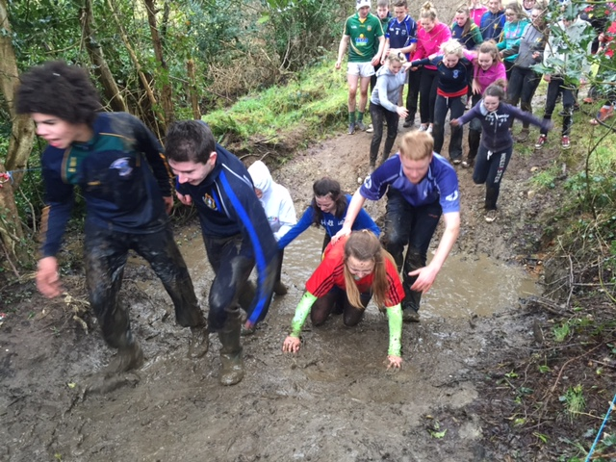
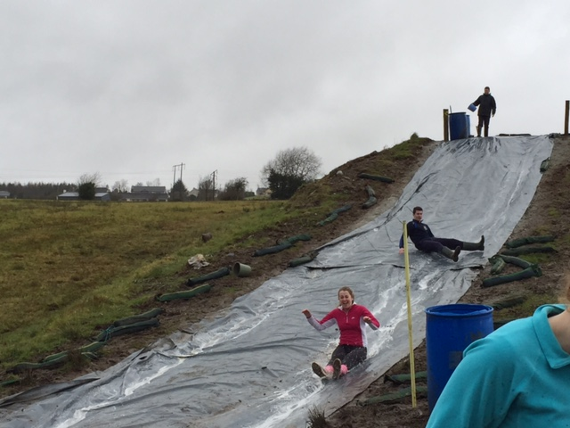
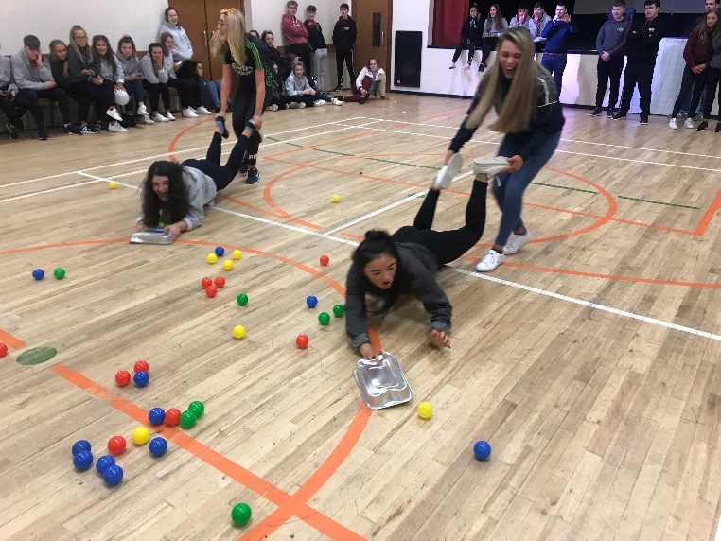
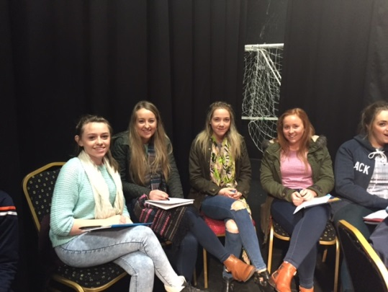
Gaeltacht Trip

Slide 16
